Slide 1

Digital Mystery Shopping

Slide 2
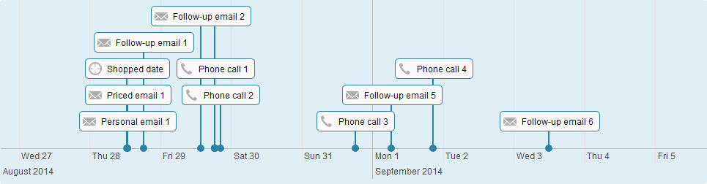
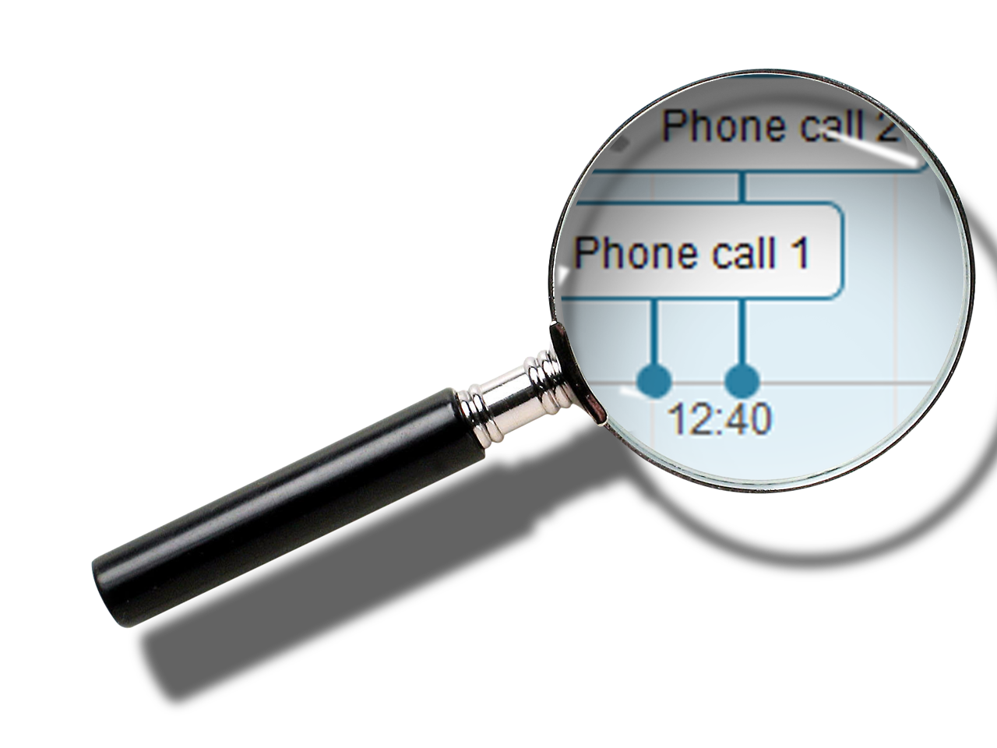
Track their patterns.
Digital Mystery Shopping

Slide 3
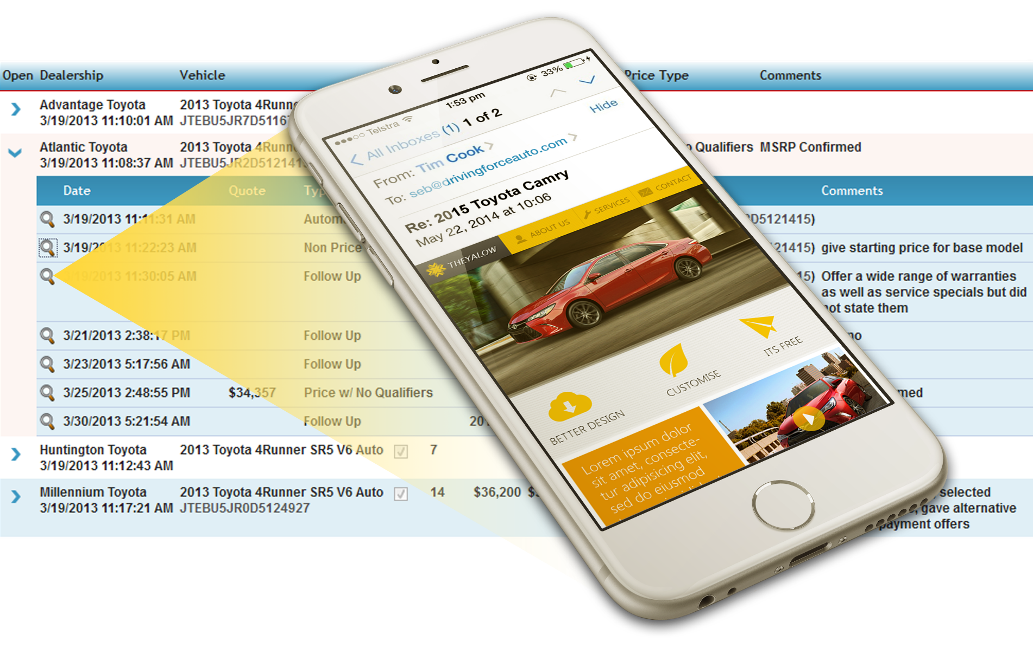
Intercept their email …
Digital Mystery Shopping

Slide 4

… everywhere.
Digital Mystery Shopping

Slide 5

Eavesdrop on their phone calls.
Digital Mystery Shopping

Slide 6
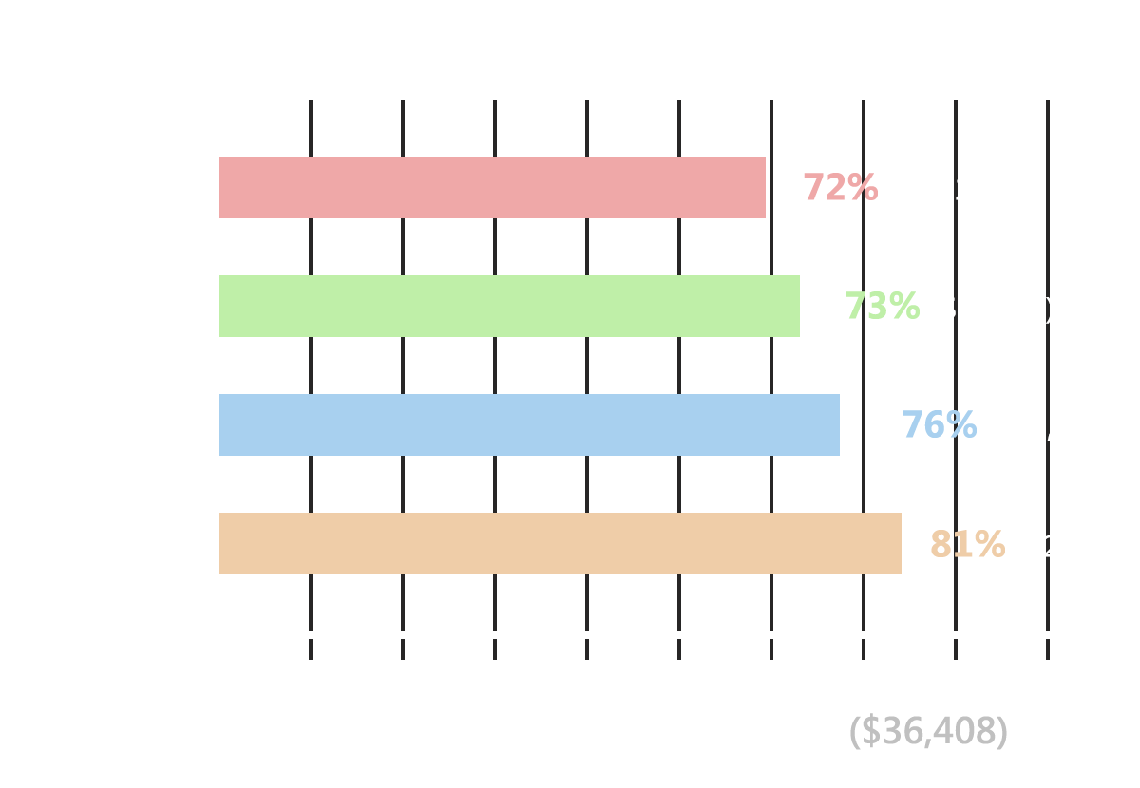
Analyze market intel.
Digital Mystery Shopping

Slide 7
Ethical Espionage.

